Slide 1

Analysis of Neural Data Using MATLAB 94873
Final Project
Ella Hanzin

Slide 2
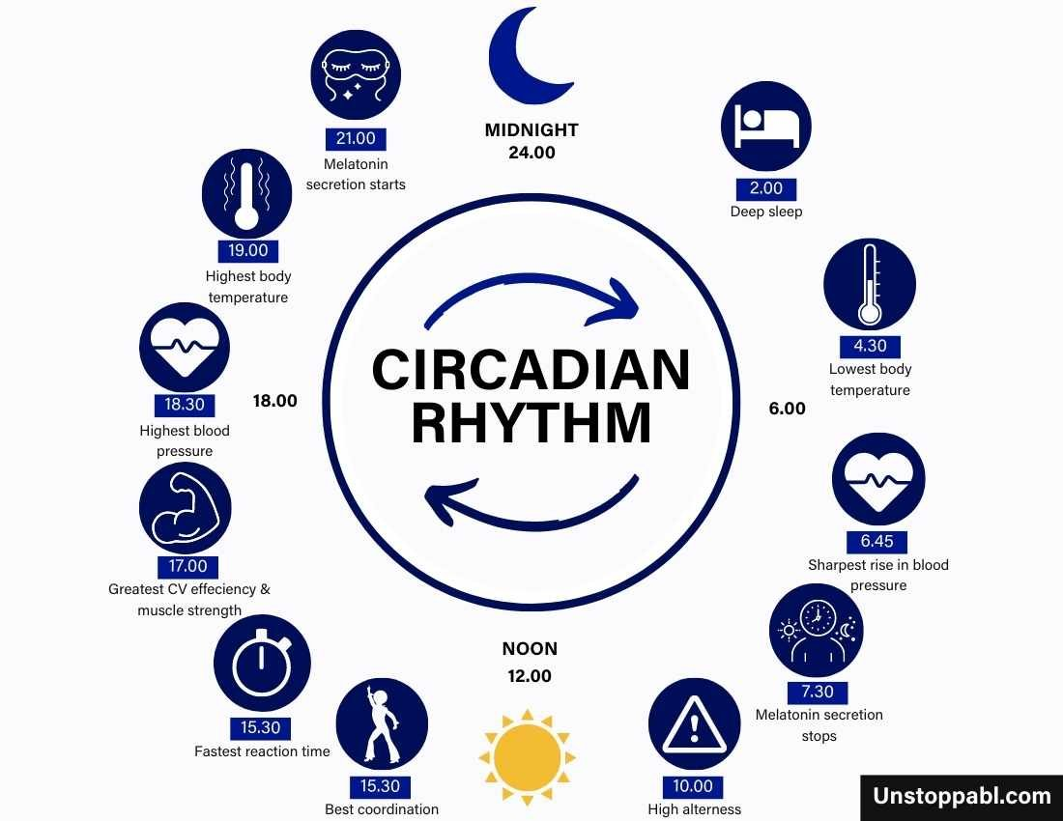


Exposure to irregular light schedules
Notes:
At our lab we research the effect of light on neuronal pathways
There is a lot of research about how irregular light schedules can cause disturbances in the circadian (סירקדיון) rhythm ,sleep,mood disorders and cognitive deficits(דיפיסיטס)
I personally look at the effect of light on depression
and the connection of anti depressions to this

Slide 3
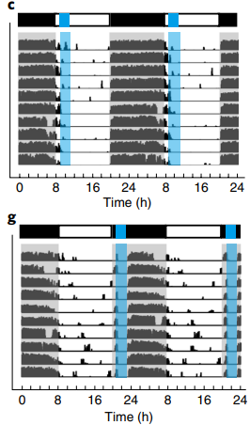
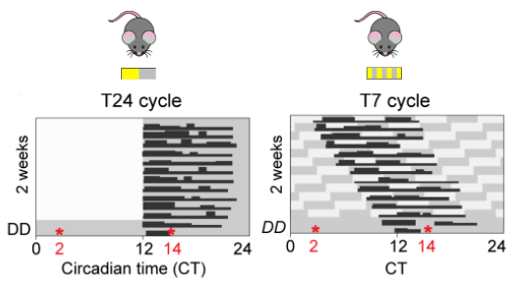
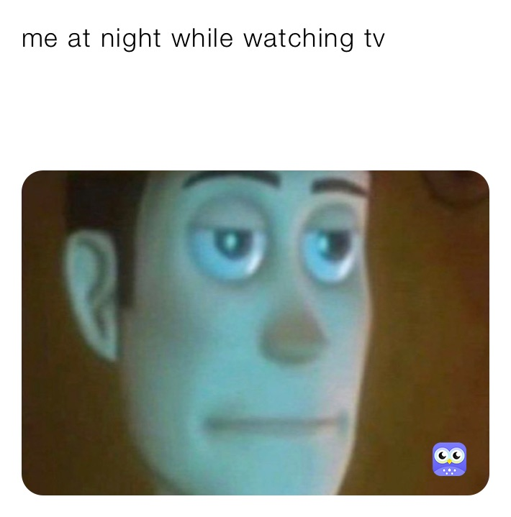
Main Goal
Have a light cycle that causes depression but doesn't change the biological clock
Weil, Tenley, et al Science Advances
An, Kai, et al Nature neuroscience
Notes:
An, Kai, et al. "A circadian rhythm-gated subcortical pathway for nighttime-light-induced depressive-like behaviors in mice." Nature neuroscience 23.7 (2020): 869-880.
Weil, Tenley, et al. "Daily changes in light influence mood via inhibitory networks within the thalamic perihabenular nucleus." Science Advances 8.23 (2022): eabn3567.

Slide 4

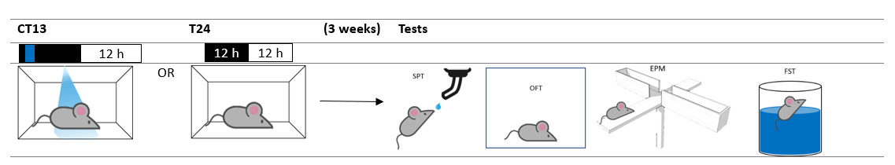
What did we do?
X 12 mice
6 mice
6 mice

Slide 5

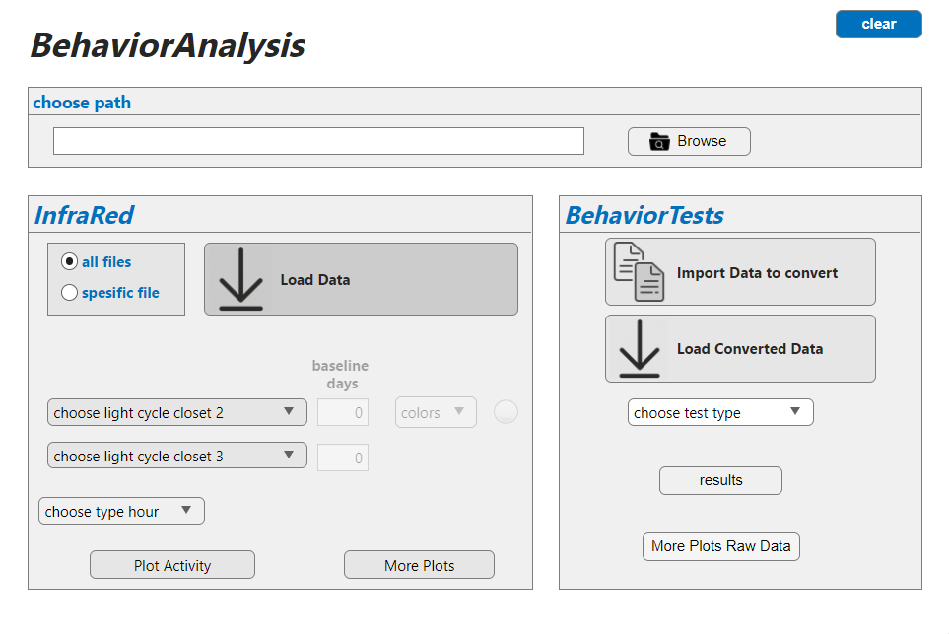
This project goal is to create a useful and friendly tool to:
Analyze the activity of mice under specific light cycles
Analyze behavior tests

Slide 6
1
Notes:
So let's start with the infrared analysis part in the GUI

Slide 7
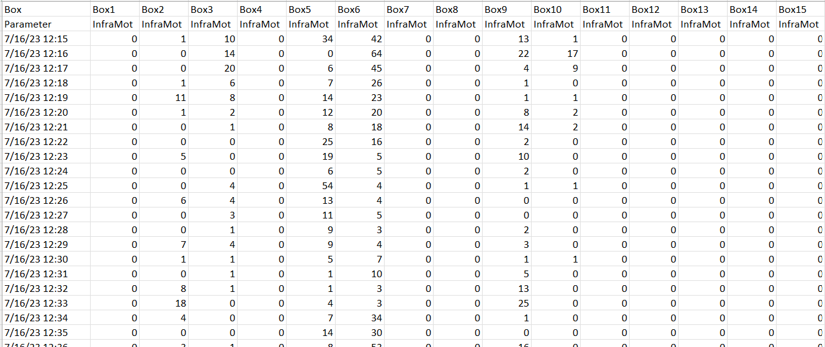
Infrared analysis
Input data
Notes:
this data is generated by an infrared sensor placed in each cage, quantifying minute-by-minute the cages activity.
As you can see the rows are time and columns are the cages

Slide 8
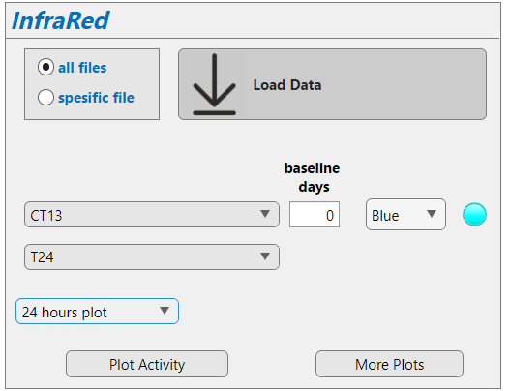

Infrared analysis
Notes:
We take this data and download it, and then we custemize the way we wanted to be plotted that means the light cycle in the closet and the type of light and if there any baseline dayse (first few days that are normal 24jh cycle)

Slide 9
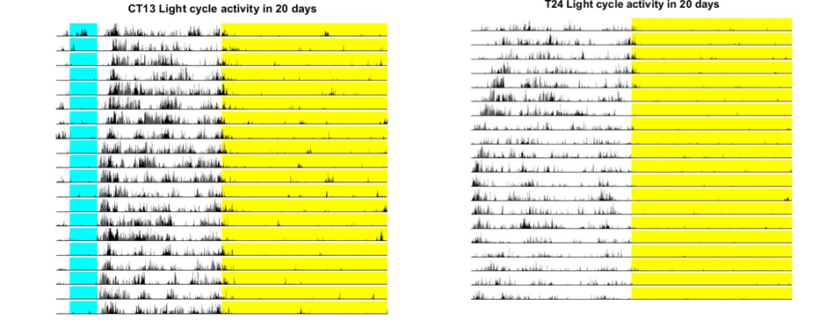
Infrared analysis
Output
Notes:
Then we plot
This plot shows the mean activity for each closet and the light cycle
As you can see with th CT13 plot there is no major shift in the cages activity. That means there biological clock is in tack

Slide 10
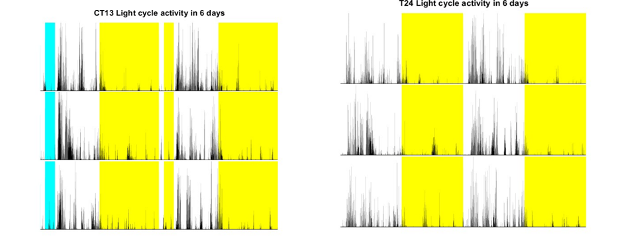
Infrared analysis
Output
Notes:
As you can see here the blue light isn't shown in the second day (its something im still working on).

Slide 11
Infrared analysis
Notes:
The user can plot more plots that might be intresting

Slide 12
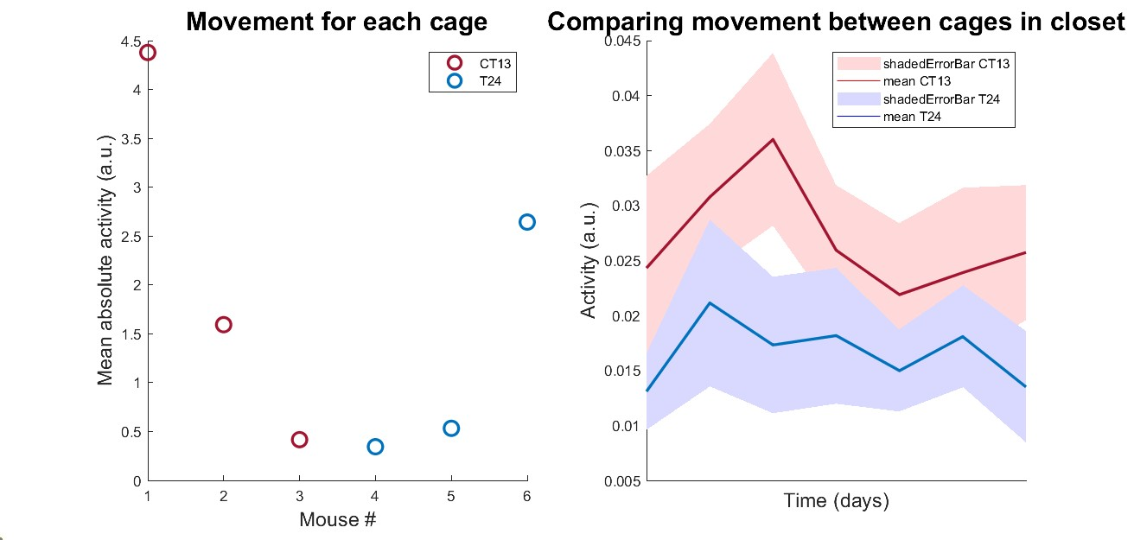
Infrared analysis
Output

Slide 13
Functions
=>function [thelist] = getFileList(varargin)
=>function [] = PlotTaVSTbn24(data,Ta,Tb,beginT24)
=>function [] = PlotTaVSTbn48(data,Ta,Tb,beginT24)
=> function [] = more_plots(data, Ta, Tb)
=>function [] = EstimateActivity(dataT)
=>function [] = differencesInActivity(dataT)
=>function varargout=shadedErrorBar(x,y,errBar,lineProps,transparent)

Slide 14
2
Notes:
So let's start with the behavior test analysis part in the GUI

Slide 15
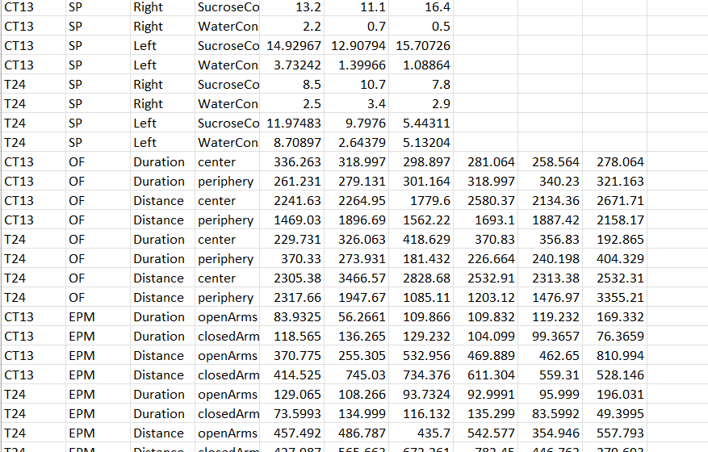
Behavior tests analysis
Input data
Notes:
The data is basically a CSV file that has the type of cycle , the type of test, the measurement, and the feature.

Slide 16
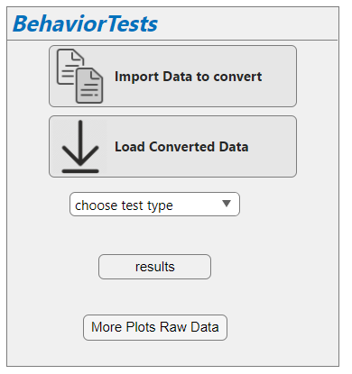
Behavior tests analysis

Slide 17
Behavior tests analysis
center
Duration
Convert to data structure
OF
periphery
CT13
Distance
center
EPM
DATA
periphery
SP
T24
FST
Groups
Test type
Components
Vectors

Slide 18
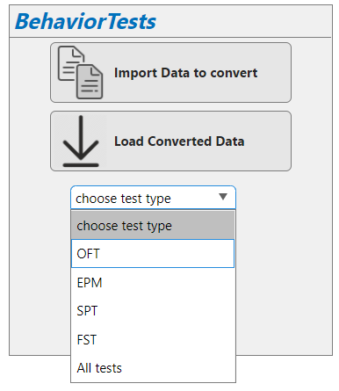
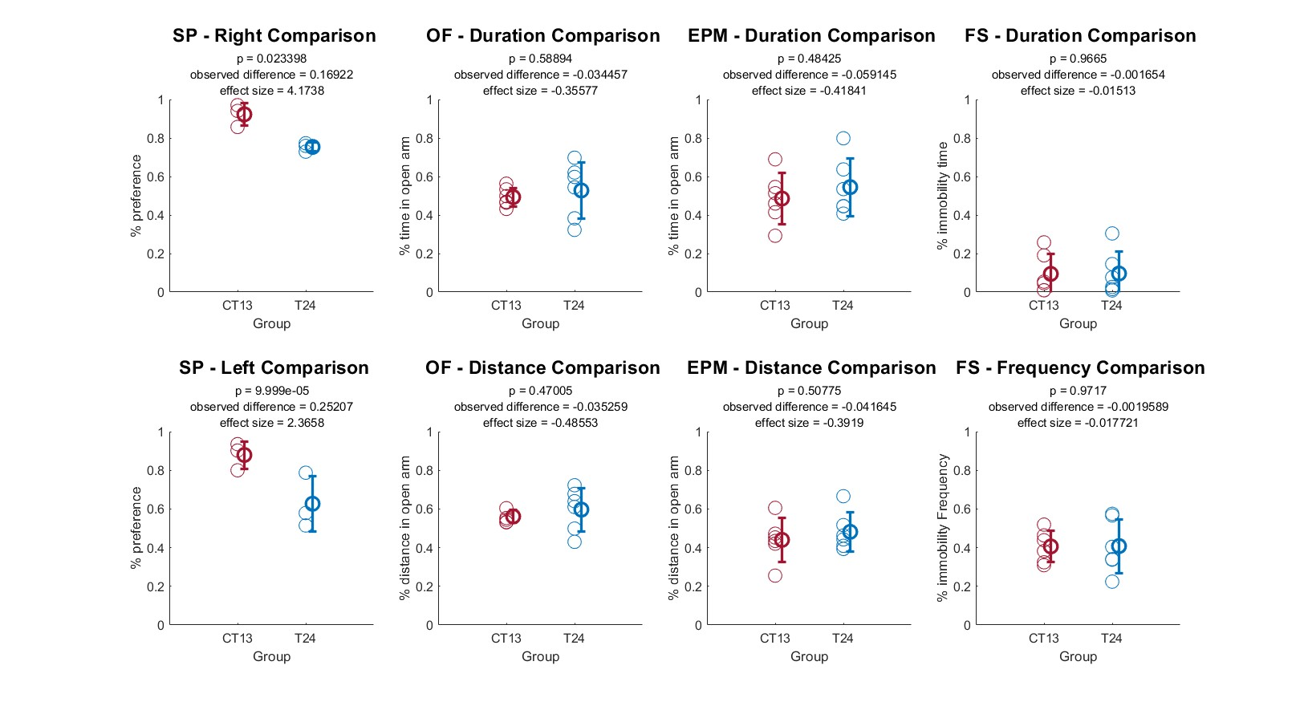
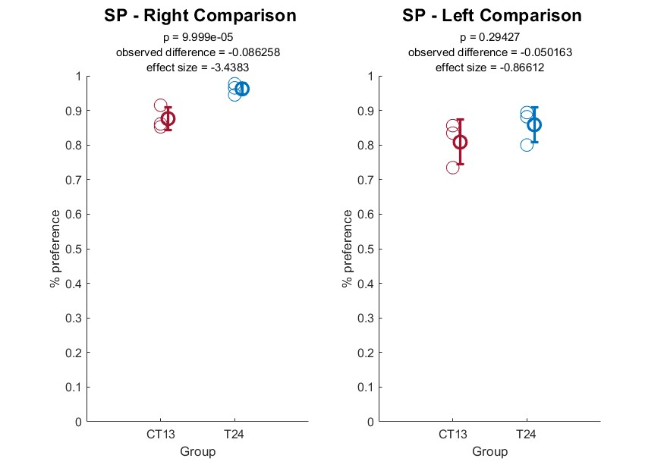
Behavior tests analysis
Choose a test to plot
Output for Analyzed data
Notes:
This plot shows me
performing a permutation t-test for the two groups and displaying the results as a subtitle

Slide 19
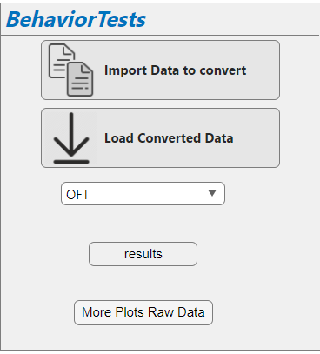
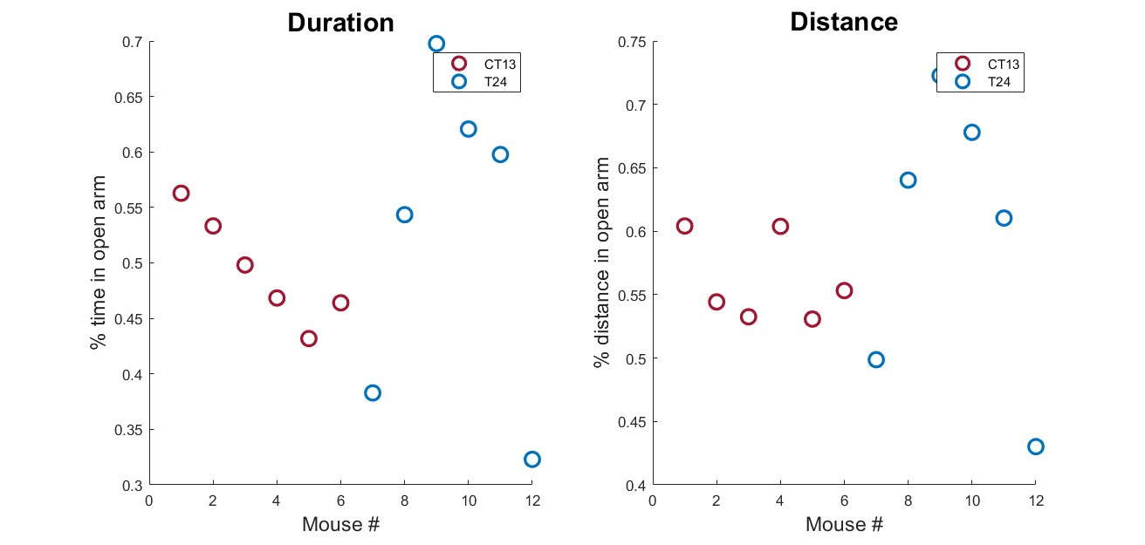
Behavior tests analysis
More plots
Output for Analyzed data
Notes:
To find the outliers

Slide 20
Functions
=>function newdata = GenConverter(path, file)
=>function [] = MyPlot(group1Data, group2Data, Groups, variableName, component, ylabelText)
=>function [] = plotGroupComparison(data, variableName, ylabelText)
=>function [] = GenAll_Plots(data,yaxlab)
=> function [myanalyzedData] = analyzingData(data)
=>function [p, observeddifference, effectsize] = permutationTest(sample1, sample2, permutations, varargin)

Slide 21



Thank you!!
Any quotations?!
https://github.com/ellahn3/BehaviorAnalysis.git

